Slide 1
Security
Avoid the danger which has not yet come

Slide 2
EISA – the BIG picture
Enterprise information security architecture (EISA)
the part of the enterprise architecture focusing on information security throughout the enterprise.
Key component of the information security technology governance process at any organization of significant size

Slide 3
The Bottom Line
Fundamentally:
Most of the damage to Information Technology (IT) security is not from outside malicious attacks, but rather from simple mistakes, unintended or unauthorized actions of legitimate users and IT engineers who are either untrained in security and/or who misunderstood the instructions from the management.
Benson Yeung, Senior Partner – TNS
…biggest problem is simple stupidity. Lax access policies and internal employees are still the biggest source of security headaches. A recent Verizon report backs this up, with research indicating that 96 percent of attacks are not sophisticated and 97 percent are easily avoidable.
eWeek - Top 10 Security Issues
Fundamentally:
Keep It Simple…
applies well to security - Complexity increases the risk of problems. Avoid complexity and avoid problems.
Notes:
http://www.eweek.com/c/a/Security/Security-Threats-Facing-All-Enterprises-Top-10-Issues-That-Need-Attention-226329

Slide 4
The Spring Fundamentals
Authentication
refers to unique identifying information from each system user, generally in the form of a username and password.
Authorization
refers to the process of allowing or denying individual user access to resources.
Spring provides for externalized authorization
Access Control List
every secure domain object has an associated definition[ACL] that defines domain object specific authorization [CRUD]
These concepts are industry wide , and not at all specific to Spring
NOTE: Core Enterprise Security is basically communication
technology agnostic [JMS,RMI, Flat File, etc.]
[ RE: it is NOT HTTP specific]

Slide 5
Spring Security
Provides authentication and authorization for enterprise applications.
These are the two main areas that Spring Security targets.
Base on 'Acegi Security' (pronounced Ah-see-gee)
Brief History
Original Acegi 2003
Apache.org 2004
Spring Project 2006
Spring Security 2008

Slide 6
Spring Security Core Classes
SecurityContextHolder helper class to provide access to the SecurityContext.
SecurityContext holds the Authentication Object [current authenticated user].
Authentication represents the principal in a Spring Security-specific manner.
GrantedAuthority reflects the application-wide permissions granted to a principal.
Helper Interfaces:
UserDetails Interface provides the necessary information to build an Authentication object from your application's “custom” DAOs or other source of security data.
UserDetailsService Interface loads & creates a “custom” UserDetails when passed in a String-based username.
Notes:
https://www.google.com/search?q=spring+security+groups+&oq=spring+security+groups+&gs_l=serp.12..0l2j0i22i30l8.6155.6155.0.7940.1.1.0.0.0.0.114.114.0j1.1.0....0...1c.1.64.serp..0.1.113.19eBf8kx3H8
https://howtodoinjava.com/spring/spring-security/custom-userdetailsservice-example-for-spring-3-security/
UserDetails see AuthenticationGroup – need to replace default DaoImpl
HOLDER is threadlocal
which means that the security context is always available to methods in the same thread of execution, even if the security context is not explicitly passed around as an argument
Groups of permissions
PRINCIPAL is current logged in user…obtained through SecurityContext [ which also holds authorities]
http://springinpractice.com/2010/10/27/quick-tip-spring-security-role-based-authorization-and-permissions
DON’T use ACL!!!!
http://stackoverflow.com/questions/1920959/group-and-acl-on-spring-security

Slide 7
Main Point
Security underlies an entire enterprise. It provides a shield that makes the application invulnerable.
Science of Consciousness: Transcendental Consciousness is characterized by the quality of invincibility, which means one cannot be overcome or overpowered.

Slide 8
Authentication
Spring supports a wide range of authentication models:
HTTP BASIC Atlassian Crowd
HTTP Digest Roller
HTTP X.509 Tapestry
Java Open Source Single Sign On (JOSSO) LDAP[Lightweight Directory Access Protocol]
Form-based Kerberos
Java Authentication and Authorization (JAAS) OpenID
Central Authentication Service (CAS) Mule ESB
Automatic "remember-me Elastic Path
Anonymous authentication AppFuse
Run-as authentication Oauth2
Notes:
no real conceptual difference between a user who is "anonymously authenticated" and an unauthenticated user.
WITH "anonymously authenticated" -- SecurityContextHolder always contains an Authentication
Run-As Authentication: a user can execute some piece of logic as another principal with different privileges.
Transparent authentication context propagation for Remote Method Invocation (RMI) and HttpInvoker (a Spring remoting protocol)
AuthenticationUserDetailsService

Slide 9
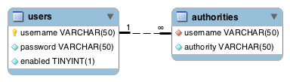
Spring Standard Authentication Tables
These standard JDBC implementation tables to load the password, account status (enabled or disabled) and a list of authorities (roles) for the user.
Each user can have zero or more “authorities”, or roles
Authority as Roles: ROLE_USER,ROLE_ADMIN…
Authority [Authorization] to do “something”
Standard JDBC implementation of the UserDetailsService (JdbcDaoImpl)

Slide 10
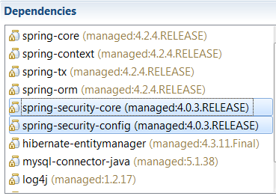
Maven Dependencies
XML NameSpace
xmlns:security="http://www.springframework.org/schema/security"
http://www.springframework.org/schema/security http://www.springframework.org/schema/security/spring-security.xsd

Slide 11
Spring Standard Authentication Provider
Configuration
<!-- Enable AOP Authorization Annotations -->
<security:global-method-security pre-post-annotations="enabled" >
</security:global-method-security>
<!-- "custom" queries are because we have used our own schema...-->
<security:authentication-manager alias="authenticationManager">
<security:authentication-provider>
<security:password-encoder hash="bcrypt" />
<security:jdbc-user-service
data-source-ref="dataSource"
users-by-username-query="select username,password,enabled
from credentials where username=?"
authorities-by-username-query="select u1.username,
u2.authority from credentials u1, authority u2 where u1.username = u2.username and u1.username =?" />
</security:authentication-provider>
</security:authentication-manager>
Notes:
security:jdbc-user-service backed by “out-of-the-box” -- org.springframework.security.core.userdetails.jdbc.JdbcDaoImpl
You need to subclass it or, need to implement your complete own UserDetailsService if you want to add fields…
See AuthenticationGroup W/R to JdbcDaoImpl support of GROUPS
The AuthenticationManager is just an interface, so the implementation can be anything we choose
The default implementation in Spring Security is called ProviderManager it delegates to a list of configured AuthenticationProviders, each of which is queried in turn to see if it can perform the authentication. Each provider will either throw an exception or return a fully populated Authentication object.
In most cases, the default AuthenticationManager[ProviderManager] is more than sufficient.
When you call:: AuthenticationManager.authenticate(new UsernamePasswordAuthenticationToken(username, password))`it is passing the UsernamePasswordAuthenticationToken to the default AuthenticationProvider, which will use the userDetailsService to get the user based on username and compare that user's password with the one in the authentication token.
AuthenticationProvider DaoAuthenticationProvider default …
Spring Security includes a production-quality AuthenticationProvider implementation called DaoAuthenticationProvider. This authentication provider is compatible with all of the authentication mechanisms that generate a UsernamePasswordAuthenticationToken, and is probably the most commonly used provider in the framework. Like most of the other authentication providers, the DaoAuthenticationProvider leverages a UserDetailsService in order to lookup the username, password and GrantedAuthority[]s. Unlike most of the other authentication providers that leverage UserDetailsService, this authentication provider actually requires the password to be presented, and the provider will actually evaluate the validity or otherwise of the password presented in an authentication request object.

Slide 12
Custom “standalone”
Authenticate a user [ login ]
AuthenticateUser.java
Authentication request = new
UsernamePasswordAuthenticationToken(name, password);
Authentication result =
authenticationManager.authenticate(request);
SecurityContextHolder.getContext().setAuthentication(result);
To Logout
// Clears the context for the current user/thread
SecurityContextHolder.clearContext();
authenticationManager DECLARED in Config
Notes:
// removes the authentication information.
SecurityContextHolder.getContext().setAuthentication(null);

Slide 13
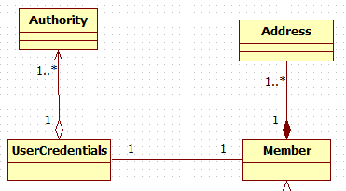
Code Example
Authority authority = new Authority();
authority.setAuthority("ROLE_USER");
authority.setUsername("Sean");
UserCredentials userCredentials = new UserCredentials();
userCredentials.setUsername("Sean");
userCredentials.setPassword("Sean");
userCredentials.setEnabled(true);
userCredentials.getAuthorities().add(authority);
Member member = new Member();
member.setFirstName("Sean");
member.setLastName("Smith");
member.setMemberNumber(1);
member.setUserCredentials(userCredentials);
memberService.saveFull(member);
SEE SecurityAuthentication DEMO
Notes:
SecurityAuthentication Demo

Slide 14
Authorization

Slide 15
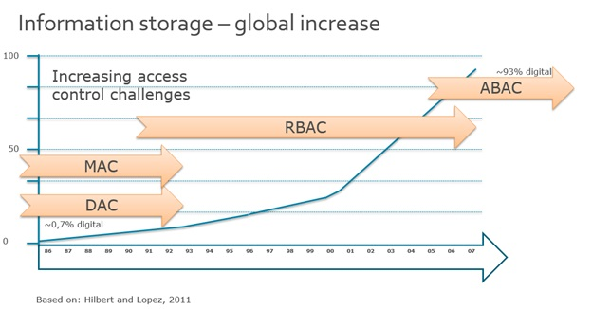
Authorization
Access Control Mechanisms
Mandatory Access – Rigid Fixed; Military
Discretionary Access – User/Admin modification of access permission
“usually” ACL based
Role Based – centered around ogranizational structure role-
permissions, user-role and role-role relationships
“can” be ACL based
Attribute Based – Attributes (user, resource, object, environment)
dynamically evaluated by policies [rules]
Access Control List

Slide 16
RBAC
Role Based Access Control
Common Enterprise approach to managing users’ access to resources
Basic Principle:
Access is through Roles - Permissions are given to Roles, not to Users.
Users are assigned to Roles.
Permissions are given to a Roles.
User has one or more Roles.
RBAC has the following model:
Many To Many relationship between Users and Roles.
Many To Many relationship between Roles and Permissions.
Roles can have a parent Role. {Hierarchy – advanced RBAC}
Notes:
The basic principle is this: instead of separately managing the permissions of each user, permissions are given to roles, which are then assigned to users, or better - groups of users.

Slide 17
RBAC Model
Role Hierarchy
Permissions are only connected to Roles
User access only through Roles
Users
Roles
Permissions
Action
Object
User - Role can be dynamically activated
Sessions

Slide 18
RBAC Applications
Addresses needs of commercial and government organizations. Used to facilitate administration of security in large organizations with hundreds of users and thousands of permissions.
However
User-centric does NOT consider attributes such as : resource information relationship between user and the resource dynamic information [e.g. time of the day or user IP].
ABAC addresses this by defining access control based on attributes RBAC is essentially a subset of ABAC with one attribute [Role].
See NIST - RBAC
Notes:
user-centric and do not take into account additional parameters such as resource information, relationship between the user (the requesting entity) and the resource, and dynamic information e.g. time of the day or user IP.
http://csrc.nist.gov/groups/SNS/rbac/

Slide 19
Attribute Based Access Control [ABAC]
ABAC is a "next generation" authorization model that provides dynamic, context-aware and risk-intelligent access control.
“By 2020, 70% of all businesses will use ABAC as the dominant mechanism to protect critical assets, up from 5% today.”
Gartner Predictions [2013]
ABAC defines access by matching the current value of
user attributes, object attributes, and environment conditions
with
requirements specified in access control policies[rules]
Notes:
ABAC tries to address this by defining access control based on attributes which describe the requesting entity (the user), the targeted object or resource, the desired action (view, edit, delete...), and environmental or contextual information. This is why access control is said to be attribute-based.
One standard that implements attribute- and policy-based access control is XACML, the eXtensible Access Control Markup Language. XACML defines an architecture, a policy language, and a request / response scheme. It does not handle attribute management (user attribute assignment, object attribute assignment, environment attribute assignment) which is left to traditional IAM tools, datatabases, and directories.
Policy & Attribute can be defined in a Technology neutral way
Microservices, Application, Database, Big Data…IoT
http://blog.gemalto.com/security/2013/11/20/gartner-iam-identity-access-management-predictions/

Slide 20
ABAC “Architecture”
User Environment Asset
Subject Attributes
Environ. Attributes
Resource Attributes
Policy
IF-Then-Else Rules
Authorization Engine
Rule Execution Demo

Slide 21
ABAC Scenario
ATTRIBUTES:
User: Group Memberships, Department ,Management level
Action: Read, etc.
Asset: Debit Account, Health Record, etc…
Environment:
Time; Physical Location; Device type [Smart phone, PC]
Policy [ Rule]
All Employees belonging to the Product Department should have full access to uploaded products between 9 am and 10 pm M-F.

Slide 22
ABAC Applications
Policy & Attributes can be defined in a Technology neutral way
Microservices, Applications,
Database, Big Data…
InternetofThings
Implementation through
XACML [eXtensible Access Control Markup Language]
standard for attribute- and policy-based access control
However
Auditing is difficult with ABAC …
The rules and attribute management can get complex..
Notes:
the auditing of the ABAC systems becomes much difficult and complicated.
Implementation of ABAC is easy
and it provides fine grained access control mechanism. But auditing remains problem in such systems.
http://www.ijircce.com/upload/2016/may/322_An.pdf
An Auditable Attribute Based Access Control Mechanism in Openstack Cloud Environment
most notably the 'attribute explosion' issue and, maybe more importantly, the lack of audibility…

Slide 23
Simple Spring “Role” Based *
Method Level Authorization Example
Configuration:
<security:global-method-security
pre-post-annotations="enabled"/>
MemberServiceImpl.java
@PreAuthorize("hasRole('ROLE_USER')")
public void findAll() {
memberDao.findAll();
* But NOT RBAC
SEE Authentication Demo [again]
Enable annotations & expression-based access control
Allows logic to be encapsulated in expression.
“SIMPLE” is keyword – not very scalable or maintainable
Notes:
SecurityAuthentication Demo
The use of the prefix ROLE_ is a marker to indicate that these attributes are roles and should be consumed by Spring Security’s RoleVoter.

Slide 24
Common built-in expressions
Expression | Description
hasRole([role]) | Returns true if the current principal has the specified role.
hasAnyRole([role1,role2]) | Returns true if the current principal has any of the supplied roles (given as a comma-separated list of strings)
hasAuthority([authority]) | Returns true if the current principal has the specified authority.
hasAnyAuthority([auth,auth]) | Returns true if the current principal has any of the supplied authorities (given as a comma-separated list of strings)
principal | Allows direct access to the principal object representing the current user
authentication | Allows direct access to the current Authentication object
permitAll | Always evaluates to true
denyAll | Always evaluates to false
isAnonymous() | Returns true if the current principal is an anonymous user
isRememberMe() | Returns true if the current principal is a remember-me user
isAuthenticated() | Returns true if the user is not anonymous
isFullyAuthenticated() | Returns true if the user is not an anonymous or a remember-me user
hasPermission(Object target, Object permission) | Returns true if user has access to target for the given permission
hasPermission(Object targetId, String targetType, Object permission) | Returns true if user has access to target for the given permission
Notes:
https://stackoverflow.com/questions/19525380/difference-between-role-and-grantedauthority-in-spring-security

Slide 25
Spring ROLE HIERARCHY
USE CASE:
ROLE_ADMIN should contain ROLE_USER privileges.
Solutions[s]:
Admin user :== ROLE_ADMIN, ROLE_USER
OR
hasAnyRole(‘ROLE_USER’,‘ROLE_ADMIN’)
OR
Configure ROLE HIERARCHY:
<bean id="roleHierarchy"
class="org.springframework.security.access.hierarchicalroles.RoleHierarchyImpl">
<property name="hierarchy">
<value>
ROLE_SUPERVISOR > ROLE_ADMIN
ROLE_ADMIN > ROLE_USER
ROLE_USER > ROLE_GUEST
</value </property>
</bean> See Hierarchy DEMO
In Authentication DEMO,
Bill has Admin Role .
He cannot execute a Member findAll() because it requires ROLE_USER!
With Role Hierarchy
Admin Role will
Assume User Role
Bill can now execute a Member findAll()
Still “SIMPLE”– not very scalable or maintainable
Notes:
SecurityAuthenticationHierarchy Demo

Slide 26
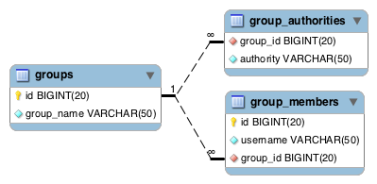
Spring Security Groups
Users and Roles are structured according to Groups
Users are organized into groups;
Roles are assigned to the groups.
User inherits Roles from Associated Group[s].
Reflects an enterprise organizational structure
Users can be moved in/out of a group “at will”…
Spring Standard Authority Groups Tables
See AuthenticationGroup Demo
Notes:
http://docs.spring.io/autorepo/docs/spring-security/4.0.0.CI-SNAPSHOT/reference/htmlsingle/#authority-groups
DEMO SecurityAuthenticationGroup

Slide 27
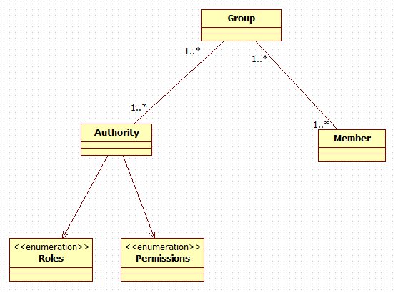
Basic RBAC Support in Spring
Many To Many Relationships
No direct Member to Permission Assignment
“Active” [Based on User session] Group Filtering **
Hierarchy of Groups [ = RBAC Roles] **
** Can be achieved through custom implementation
** Advanced RBAC - can be achieved using LDAP
Notes:
** Can be achieved through custom implementation
See SecurityAuthenticationGroup [commented out code at bottom of Main]
LDAP has groups..nested/hierarchy – can load authorities into spring:
The DefaultLdapAuthoritiesPopulator is an implementation which will load the authorities by searching the directory for groups of which the user is a member (typically these will be groupOfNames or groupOfUniqueNames entries in the directory

Slide 28
Permission Based Access
As a general rule, prefer permission-based access to role-based access. There are exceptions to this rule, but it holds as a general rule.
Maintaining correct Authorization [Adding & Deleting ROLES] is an ongoing code level task
@PreAuthorize("hasAnyRole('ROLE_USER',‘ROLE_ADMIN','ROLE_SUPERVISOR')")
public Member getMember(long id){ ... }
VERSUS
@PreAuthorize("hasAuthority('READ')")
public Member getMember(long id){ ... }
This is more maintainable since access is based on READ permission. Just remove permission from GROUP instead of modifying inline annotations
See AuthGroupPermission DEMO
Assume ROLE_s NOT hierarchical
Notes:
http://javabeat.net/separating-roles-and-permissions-in-spring-security/
Assume ROLES are NOT hierarchical
Could need resource based granularity
[member_read, etc. -- something like forum might be a better example]

Slide 29
Custom Rule Authorization
Authorization can get more complicated than simple allow/deny access.
Authorization decisions need to be made concerning the actual domain object
Fine grained object Control
The built-in hasPermission() expression is linked into the Spring Security ACL
We can create a
Custom implementation of PermissionEvaluator allows for custom rules

Slide 30
Override ACL permissionEvaluator
<security:global-method-security pre-post-annotations="enabled" >
<security:expression-handler ref="methodExpressionHandler"/>
</security:global-method-security>
<bean id="methodExpressionHandler"
class="org.spring...DefaultMethodSecurityExpressionHandler">
<property name="permissionEvaluator">
<bean id="permissionEvaluator"
class="edu.mum.security.rules.CustomPermissionEvaluator"/>
</property>
</bean>

Slide 31
Rule Execution Demo Implementation
@PreAuthorize("hasPermission(#comment,'update')")
public void update(Comment comment)
______________________________________________________________________________________________________________________
public class CustomPermissionEvaluator implements PermissionEvaluator
@Override
public boolean hasPermission(Authentication authentication,
Object targetDomainObject, Object permission) {
// Setup “environment” values
environment.put("timeZone" , authenticateUser.getTimeZone());
// Look up asset specific policy/rules
Policy policy= (Policy)
Main.policyList.get(targetDomainObject.getClass().getSimpleName());
// policy is ABAC context [User, action, asset, environment]
return policy.checkRules(authentication, (String)permission,
targetDomainObject, environment);
ABAC Architecture
Notes:
Current does permission/action as “update’ – pretty generic…
HOWEVER “update” could have a different context for Member .vs. Comment – you would
Want to do something like comment_update or have admin_update…depending on organizational structure

Slide 32
Spring & ABAC
Spring Security ABAC Support
Utilizes cross-cutting concern
Separates application logic from rule logic.
Has the capability to support XACML
By Example: **
Axiomatics[3rd party vendor] provides an SDK for integrating XACML into
Spring Security Enterprise Java applications.
Axiomatics -Enhancing Spring Security
The SDK provides three core capabilities:
URL level access control using Web Expressions WEB
UI level access control using JSP Tag library WEB
Method level access control (PreAuthorize, PostAuthorize, PreFilter and PostFilter)
**NOTE: Essentially an XACML implementation of hasPermission.
Notes:
It explains how the Spring Express Language (SpEL) (introduced in v3) can be extended to implement custom expressions to call out to the XACML PDP for an authorization decision at the URL and UI (Web Expression) as well method (Method Expression) level.
https://www.axiomatics.com/resources/webinars-tutorials/362-webinar-enhancing-spring-security.html
http://stackoverflow.com/questions/19618704/spring-security-integration-with-xacmlor-any-other-policy-based-solution
What we have implemented can in fact
be considered as a XACML specific implementation of hasPermission.

Slide 33
Summary
Access Control on Service Methods
Check for Role [Spring definition of Role]
@PreAuthorize("hasRole('ROLE_ADMIN')")
public void delete(Comment comment) {
Check for Permission[ AKA Authority] @PreAuthorize("hasAuthority(DELETE')")
public void delete(Comment comment) {
Check against [custom] Rule
@PreAuthorize("hasPermission(#comment,'update')")
public void update(Comment comment)
“SIMPLE”
Use with groups [RBAC]
Fine grained [ABAC]
SpEL syntax
#comment refers to method argument NAME
it is checking for
Update Permission
Notes:
The use of the prefix ROLE_ is a marker to indicate that these attributes are roles and should be consumed by Spring Security’s RoleVoter.

Slide 34
Main Point
Spring Security allows for authentication and authorization of system users. It gives access to resources “appropriately”. It works as a stabilizing factor in the enterprise infrastructure
Science of Consciousness: Securing life at its basis - at the underlying field of Creative Intelligence – guarantees stability and success at all levels

